Slide 1
Indian Housing Markets Analysis and Visualization
Team Members:
M. Sri Manish Reddy (21911A05G7)
B. Nilesh (21911A05D7)
B. Rakesh Kumar (21911A05D9)
B. Srikanth (21911A05E2)
Project Guide: Ms. A. Lalitha
Project Coordinators: Ms. G. Surekha Ms. K. Spandana Kumari

Slide 2
Abstract
The project aims to conduct a thorough analysis of housing market in India using advanced data analysis techniques. By leveraging libraries such as NumPy, Pandas, Matplotlib, scikit-learn, and Seaborn, the project will focus on data preprocessing, manipulation, statistical analysis, and creating visualizations. These visualizations will reveal underlying trends and patterns within the dataset, offering insights that are crucial for understanding the factors that influence housing prices. The outcome of this project will provide a comprehensive understanding of the housing market, facilitating data-driven decision-making.

Slide 3
Introduction
The Indian housing market is a complex and dynamic system influenced by various economic, social, and political factors. Understanding these factors is essential for buyers, sellers, policymakers, and investors.
The traditional methods of real estate analysis often fall short in capturing the full scope of the data available. This project seeks to address this gap by applying modern data analysis techniques to provide a deeper insight into housing price trends.
The primary aim is to analyze and visualize these trends, making the data more accessible and understandable for stakeholders involved in the housing market.

Slide 4
Existing System/ Literature Survey
Traditional Analysis Approaches:
- Rely heavily on basic statistical tools like averages and medians to summarize housing prices.
- Often focus on limited variables, such as location and size, without exploring deeper correlations.
Limitations of Existing Literature:
- Lack of comprehensive Exploratory Data Analysis (EDA) that could uncover hidden patterns in the data. Many studies fail to visualize complex relationships between multiple factors like economic indicators, infrastructure development, and market sentiment.
Gap in Current Research:
- Most analyses overlook the use of advanced data visualization techniques that can provide actionable insights.- Limited focus on the integration of modern data in real estate market studies, which restricts the depth of analysis.

Slide 5
Proposed System
Data Preprocessing and Exploratory Data Analysis (EDA):
- Clean and organize raw data to ensure consistency. and standardize formats to prepare the dataset for analysis.
- Identify correlations, trends, and patterns within the data distribution across different regions.
Data Visualization:
- Visual tools will reveal relationships between factors like location, size, demand, and price, aiding in better decision-making.
System Implementation:
- Utilize Python libraries such as NumPy, Pandas, Matplotlib, scikit-learn, and Seaborn for efficient data manipulation and visualization.
- Ensure the system is scalable, capable of handling large datasets, and user-friendly with an intuitive interface.

Slide 6
Requirements
Hardware Requirements:
A computer with at least 4GB RAM and a modern processor.
Software Requirements:
Python 3 with libraries such as NumPy, Pandas, Matplotlib, Seaborn, scikit-learn. IDE such as Jupyter Notebook or VS Code
Data Requirements:
A well-curated dataset containing various features affecting housing prices (e.g., location, size, amenities, prices, demand).

Slide 7
Scope of the Project
This project focuses on analyzing housing market within India, including data preprocessing, EDA, and visualization.
While the current scope is limited to analysis, future expansion could include predictive modeling and real-time data integration.
The insights generated will be valuable for real estate agents, investors, and policymakers for strategic planning.

Slide 8
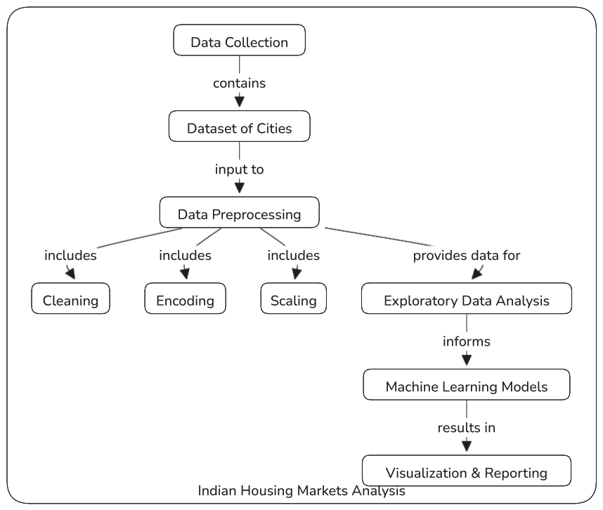
Architecture

Slide 9
Modules
1. Data Acquisition Module:
- Collects data from various
- Stores raw data in a structured format
2. Data Preprocessing Module:
- Handles missing values and outliers
- Normalizes and standardizes data
- Encodes categorical variables
3. Exploratory Data Analysis (EDA) Module:
- Computes descriptive statistics
- Identifies correlations and patterns
4. Visualization Module:
- Creates different plots and graphs.
- Generates interactive visualizations
5. Reporting Module:
- Compiles analysis results and visualizations
- Generates comprehensive reports

Slide 10
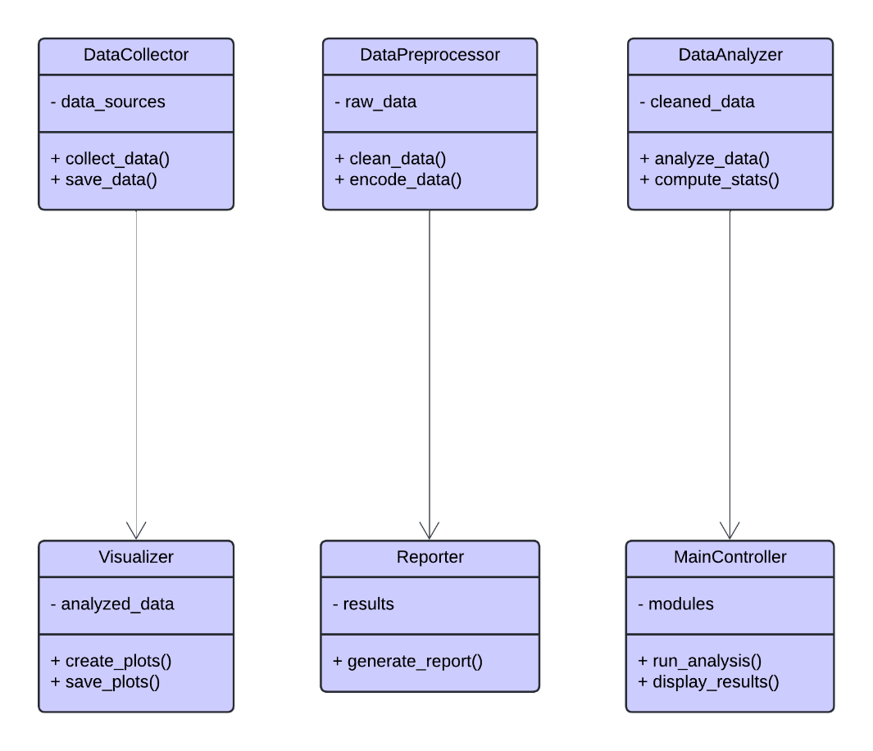
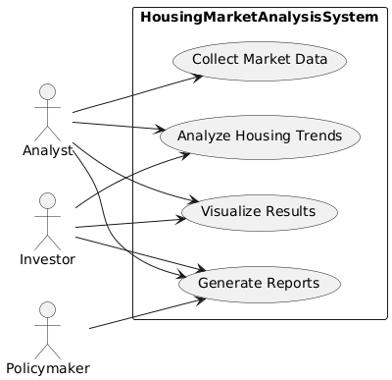
Design (UML Diagrams)
Class Diagram
Use Case Diagram

Slide 11
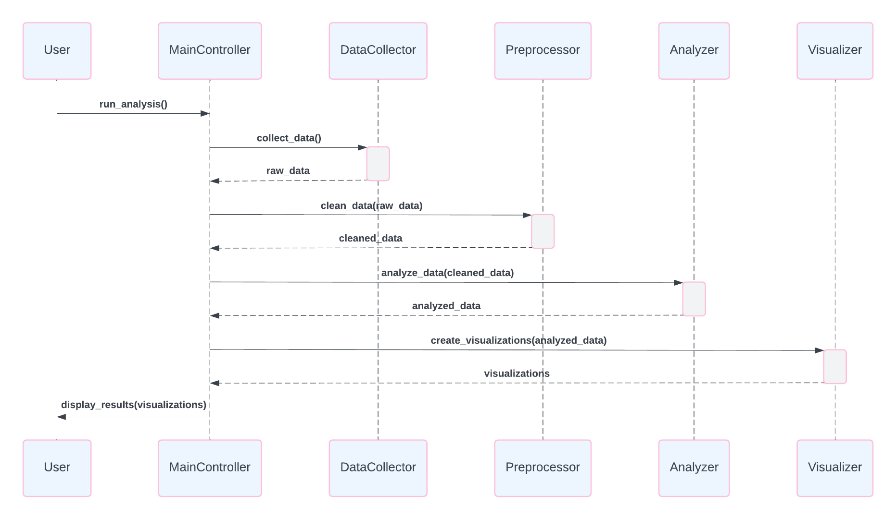
Design (UML Diagrams)
Sequence diagram

Slide 12
Implementation
1. Data Collection:
- Collect data of various indian cities
2. Data Preprocessing:
- Utilize Pandas for data cleaning and transformation
- Apply scikit-learn for feature scaling and encoding
3. Exploratory Data Analysis:
- Use NumPy and Pandas for statistical computations
- Implement correlation analysis using scikit-learn

Slide 13
Implementation
4. Data Visualization:
- Create static plots using Matplotlib
- Generate interactive visualizations with Plotly
5. Reporting:
- Use Jupyter Notebooks for creating interactive reports
- Implement automated report generation using libraries like ReportLab

Slide 14
Conclusion
This project aims to enhance traditional real estate analysis by applying advanced techniques.
Effective data preprocessing, EDA, and visualization will provide a comprehensive understanding of housing price determinants.
The project not only fills gaps in existing literature but also paves the way for future research in housing market analysis.

